Slide 1
Assessments of gradient search and particle swarm intelligence
Albert, Louis, Sweta

Slide 2
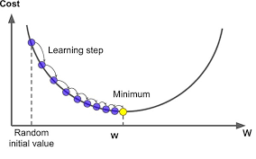
Description
Find the maximum of a Gaussian function in a 3D model
Initial measurement: gradient search

Slide 3
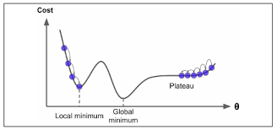
Challenge
Gradient search crashes in noisy Gaussian function
Noisy Gaussian contains two part: Gaussian, and random noise
Why?------noise makes it lost

Slide 4
How to do?
Swarm intelligence
Optimizations on Gradient search
Reinforcement learning
Supervised learning
SA(simulated annealing)

Slide 5
Swarm intelligence
Particles are generated randomly over the whole domain
Particles will not only make contact with each other, but also move to a better position

Slide 6
What is PSO?
In PSO, a population of particles moves around in a search space, looking for the optimal solution. Each particle represents a potential solution, and the algorithm updates the velocity and position of each particle in the search space in order to find the best solution.
The algorithm works by iteratively updating the position and velocity of each particle based on its own best solution found so far (its personal best) and the best solution found by any particle in the swarm (the global best). This process continues until the algorithm converges to an optimal solution or reaches a stopping criterion.

Slide 7
Graph #1

Slide 8
Probability of Success v.s. SNR
Definition of success:
The value goes into the band and keeps 50 percent time within the band from the starting point to the end of iteration.
The starting point is the first time the average value of 10 consecutive iterations goes within the band.
The band is >0.9*max and max is 1
How Data is Generated?
Do 1000 experiments at each SNR
Probability of success=#successful experiments/1000

Slide 9
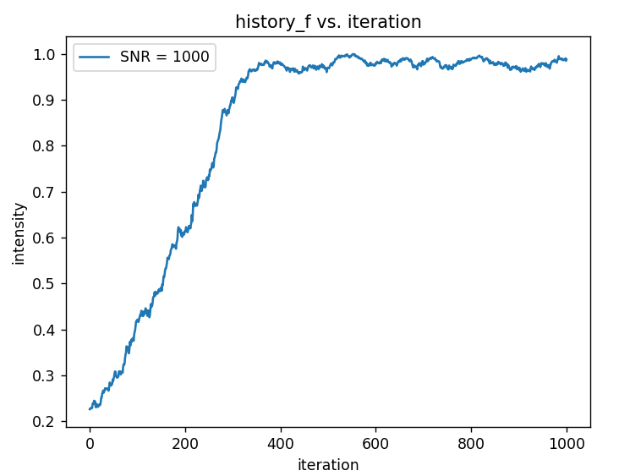

Slide 10
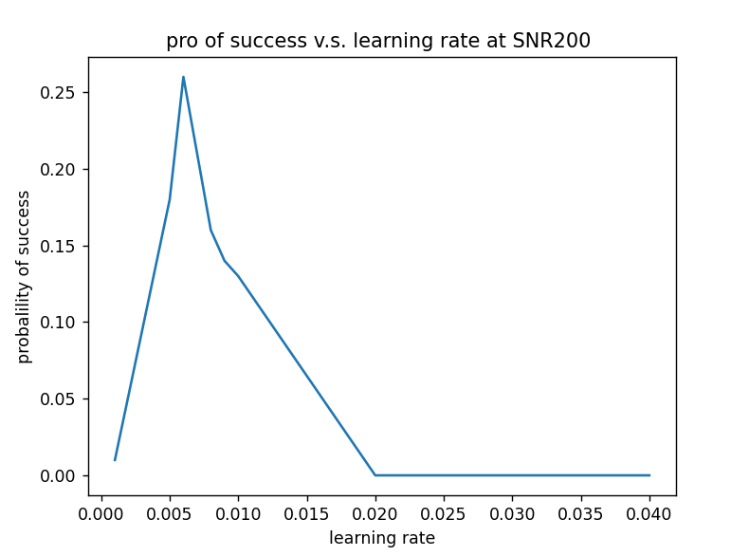
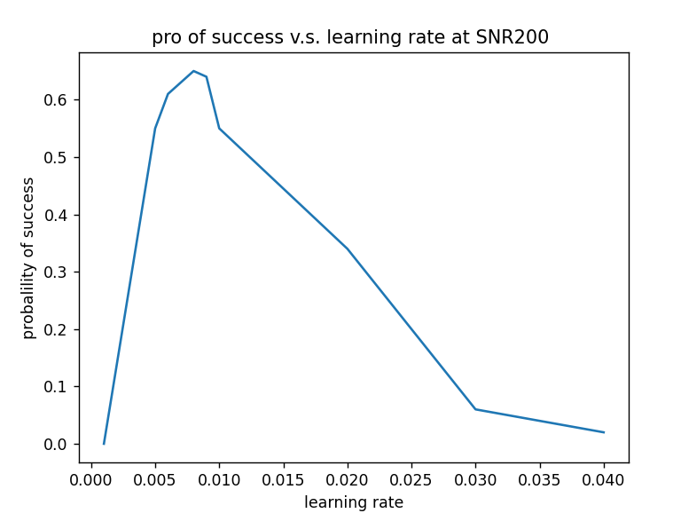
Find the best learning rate of Gradient search

Slide 11
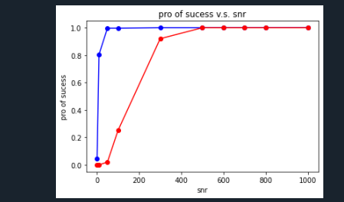
Probability of Success v.s. SNR
PSO
Gradient search

Slide 12
Graph #2

Slide 13
Average movements of first success v.s. SNR
Definition of success
Definition of movements:
Every movements of piezo, same as the iteration in Gradient search
Movements=Iteration * #particles
How to calculate average movements?
From the 5th of the first ten points whose average is within the band
Do 1000 experiments at each SNR
Average movements =#sum(movements)/1000

Slide 14
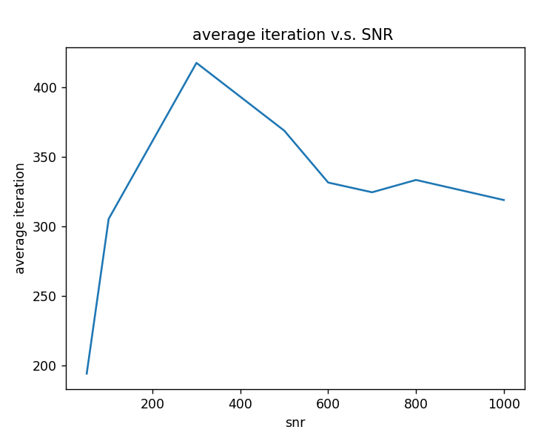
Average movements of first success v.s. SNR
Gradient search with learning rate 0.008

Slide 15
the average iterations is going down for SNR<~300 because there are very few successful cases, and the only successful ones are with less iterations.

Slide 16
Graph #3

Slide 17
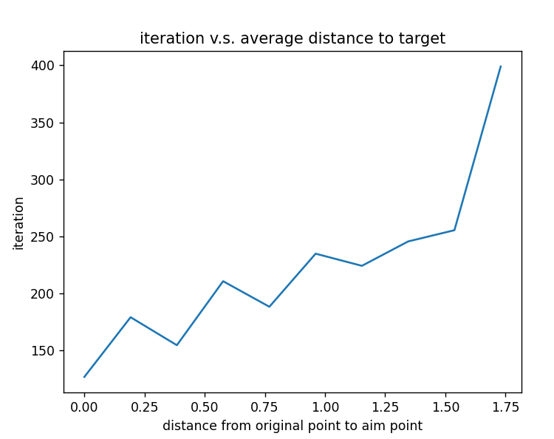
Average movements of success v.s. Average initial average distance for gradient search when SNR = 100
Gradient search

Slide 18
Graph #4
Probability of success v.s. initial average position when SNR==1000
For gradient search, each iterate 100 times

Slide 19
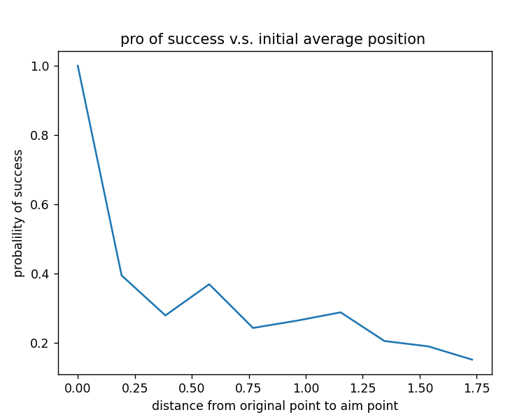
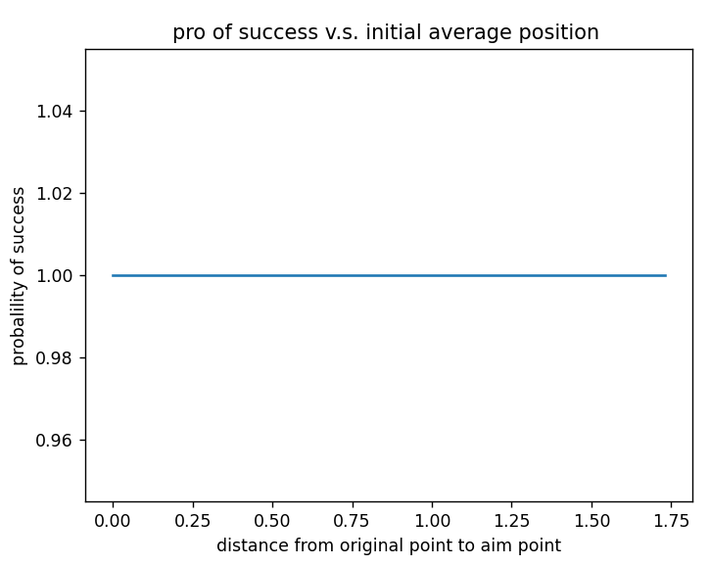
pro of success v.s. initial average position when SNR==100
PSO
Gradient search
with learning rate 0.008

